Slide 1

8th Grade Math: Pre-Algebra
Unit 5, Lesson 5 Applying the Triangle Inequality Theorem Volume 1, pg. 196

Slide 2


Benchmark
MA.8.GR.1.3
Use the Triangle Inequality Theorem to determine if a triangle can be formed from a given set of sides. Use the converse of the Pythagorean Theorem to determine if a right triangle can be formed from a given set of sides.
volume 1, pg. 196

Slide 3
Integrated Mathematical Thinking and Reasoning Standards
MA.K12.MTR.1.1 Actively participate in effortful learning both individually and collectively.
MA.K12.MTR.3.1 Complete tasks with mathematical fluency.
MA.K12.MTR.4.1 Engage in discussions that reflect on the mathematical thinking of self and others.
MA.K12.MTR.5.1 Use patterns and structure to help understand and connect mathematical concepts.
MA.K12.MTR.7.1 Apply mathematics to real-world contexts.
volume 1, pg. 196

Slide 4

Learning Targets
I can use the Triangle Inequality Theorem to determine if a given set of values makes a triangle.
I can use the Triangle Inequality Theorem to determine possible values for the third side of triangle when given two sides.
volume 1, pg. 196

Slide 5

Warm-Up
volume 1, pg. 196

Slide 6
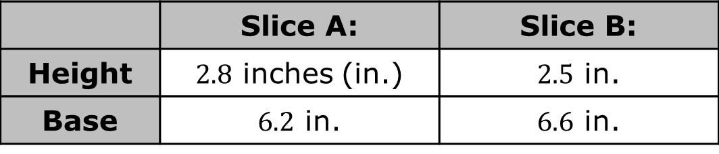
5.5.1 Warm-Up: Would You Rather?
The dimensions of two slices of pizza cut into triangles are given in the table.
Explain which slice of pizza you would rather eat.
Which slice of pizza has the larger area?
 | Slice A: | Slice B:
Height | $2.8$ inches (in.) | $2.5$ in.
Base | $6.2$ in. | $6.6$ in.
volume 1, pg. 196

Slide 7

Collaboration
volume 1, pg. 197

Slide 8

5.5.2 Collaboration: Exploring the Triangle Inequality Theorem
Put both of your elbows on your desk. Face your hands toward each other, then move them down until they are flat on the desk with only the fingertips touching. Slowly raise your hands up without moving your elbows.
What do you notice about the length of your arms and the distance between your elbows?
What do you wonder about creating a triangle with these lengths?
volume 1, pg. 197

Slide 9
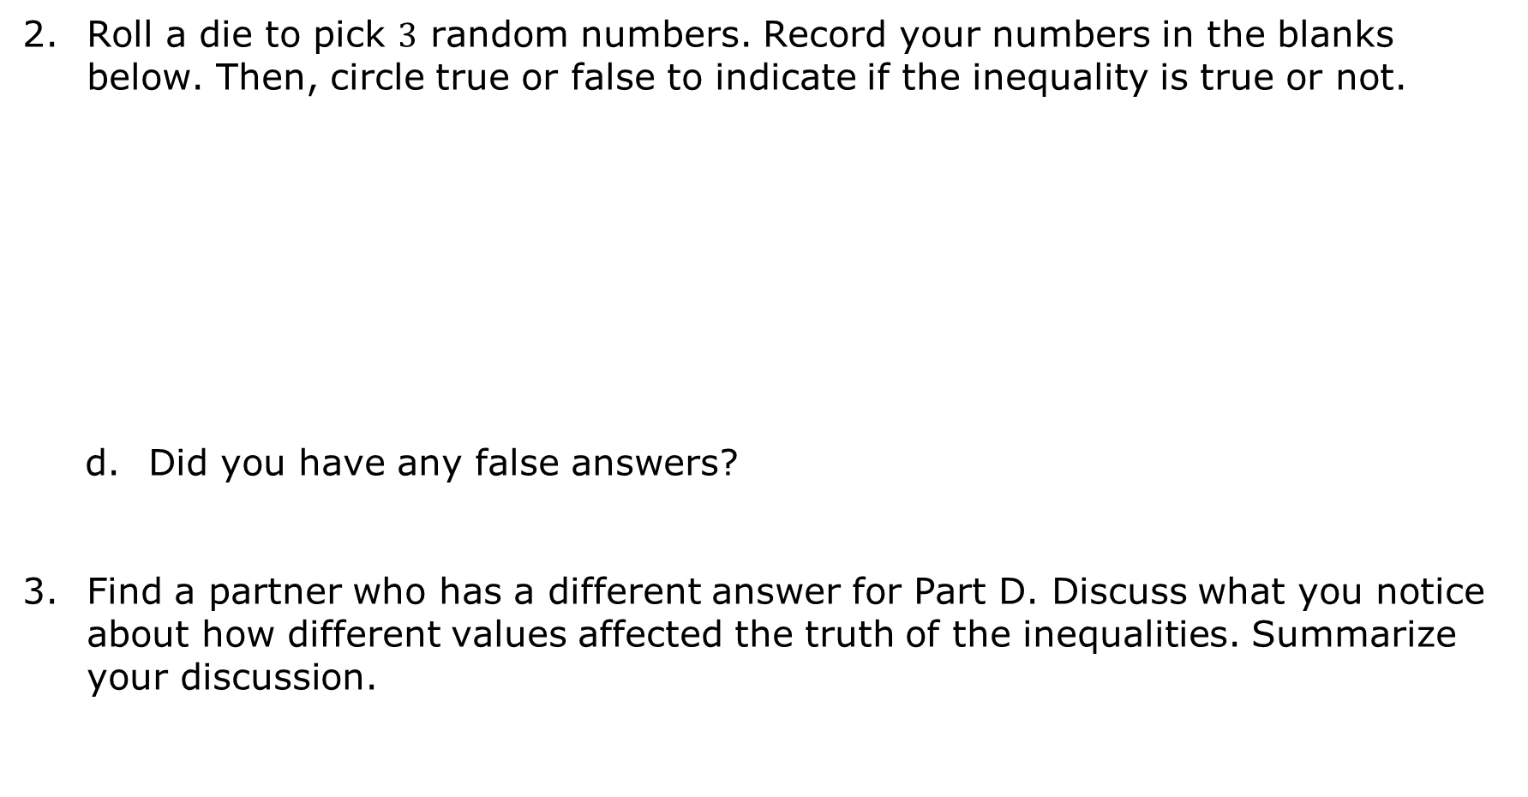
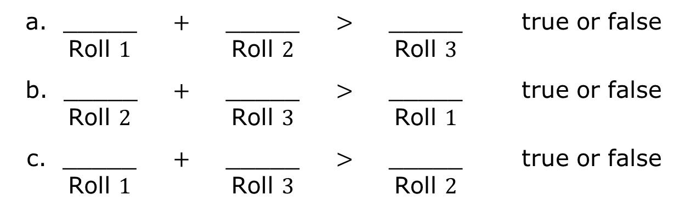
Roll a die to pick $3$ random numbers. Record your numbers in the blanks below. Then, circle true or false to indicate if the inequality is true or not.
Did you have any false answers?
Find a partner who has a different answer for Part D. Discuss what you notice about how different values affected the truth of the inequalities. Summarize your discussion.
a. _____ Roll $1$ | + | _____ Roll $2$ | > | _____ Roll $3$ | true or false
b. _____ Roll $2$ | + | _____ Roll $3$ | > | _____ Roll $1$ | true or false
c. _____ Roll $1$ | + | _____ Roll $3$ | > | _____ Roll $2$ | true or false
volume 1, pg. 197

Slide 10

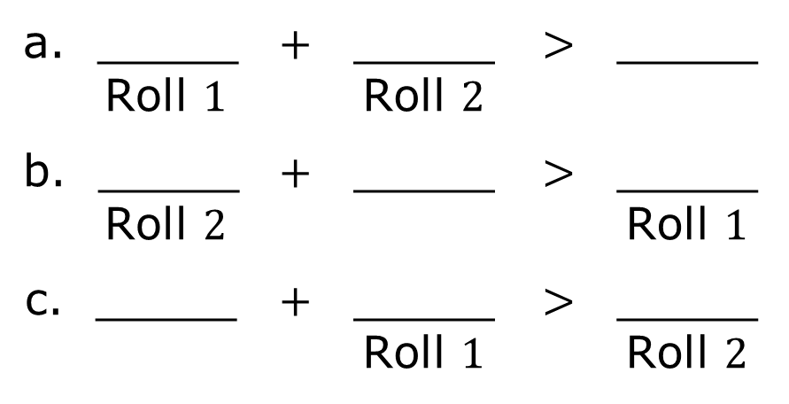
Roll a die to pick $2$ random numbers. Record your numbers on the blanks labeled for each roll. Leave any other lines blank.
Determine one value that will satisfy all three inequalities based on the values already inserted from rolling the die.
a. _____ Roll $1$ | + | _____ Roll $2$ | > | _____
b. _____ Roll $2$ | + | _____ | > | _____ Roll $1$
c. _____ | + | _____ Roll $1$ | > | _____ Roll $2$
volume 1, pg. 197

Slide 11

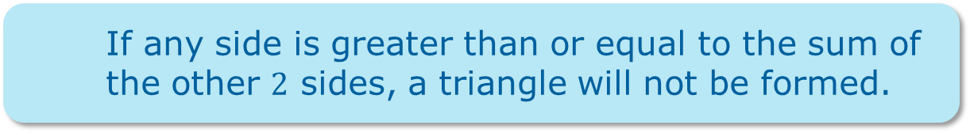
Complete the statement.
The says any of a triangle is than the of the other two sides.
Triangle Inequality Theorem
Pythagorean Theorem
side
angle
more
less
difference
sum
If any side is greater than or equal to the sum of the other $2$ sides, a triangle will not be formed.
volume 1, pg. 198

Slide 12
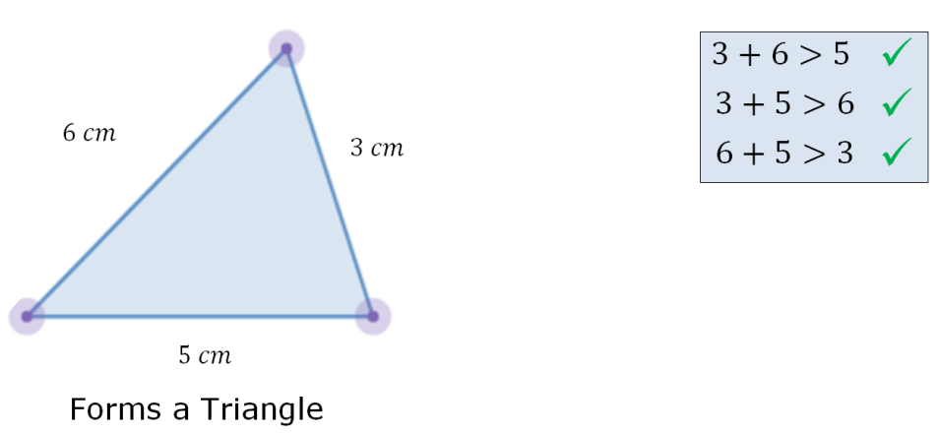
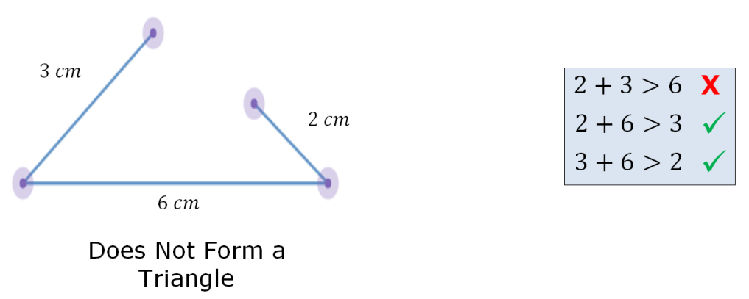
An example and a non-example are shown.
volume 1, pg. 198

Slide 13

Guided Practice
volume 1, pg. 198

Slide 14

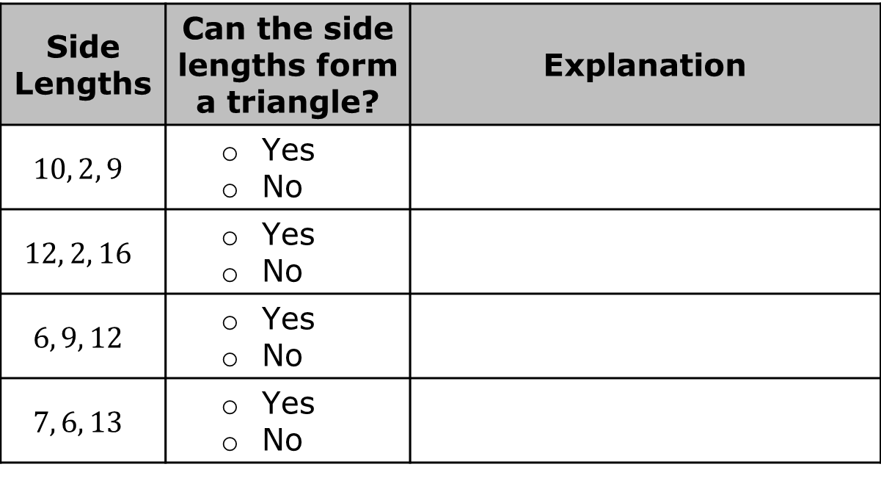
5.5.3 Guided Practice: Applying the Triangle Inequality Theorem
Use the given sets of side lengths in the table to determine if a triangle can be formed. Use the explanation column to explain or show why or why not.
Side Lengths | Can the side lengths form a triangle? | Explanation
$$10, 2, 9$$ | Yes No
$$12, 2, 16$$ | Yes No
$$6, 9, 12$$ | Yes No
$$7, 6, 13$$ | Yes No
volume 1, pg. 198

Slide 15
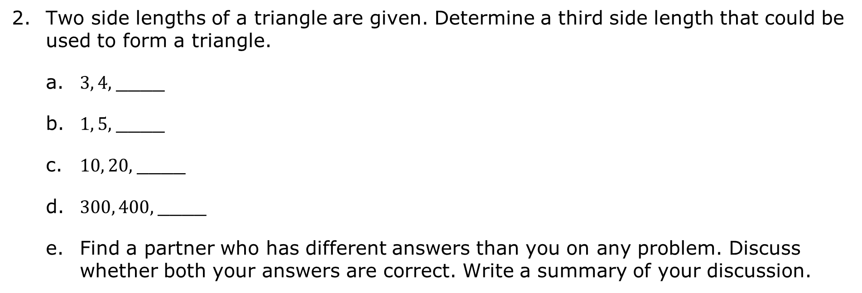
Two side lengths of a triangle are given. Determine a third side length that could be used to form a triangle.
a. $3, 4,$____
b. $1, 5,$____
c. $10, 20,$____
d. $300, 400,$____
Find a partner who has different answers than you on any problem. Discuss whether both your answers are correct. Write a summary of your discussion.
volume 1, pg. 199

Slide 16

Your Turn
volume 1, pg. 199

Slide 17
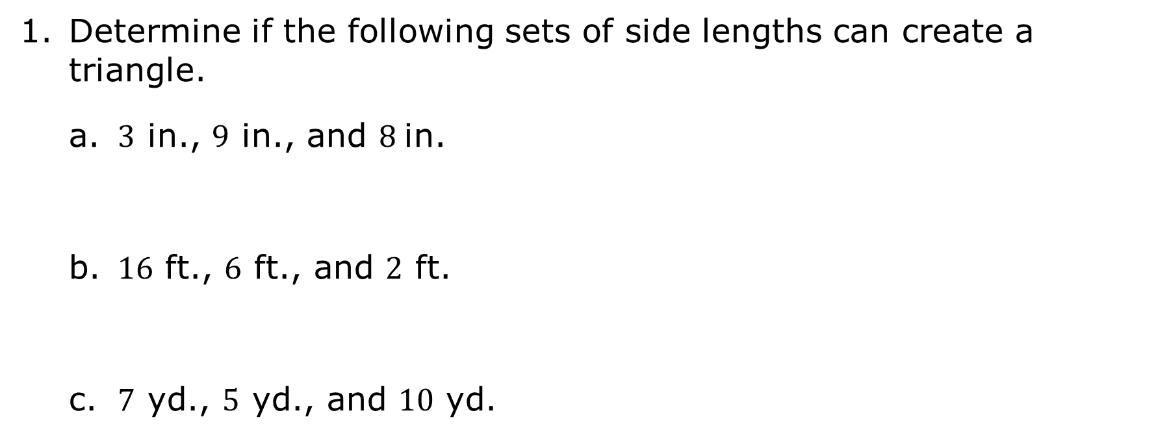
5.5.4 Your Turn!
Determine if the following sets of side lengths can create a triangle.
a. $3$ in., $9$ in., and $8$in.
b. $16$ ft., $6$ ft., and $2$ ft.
c. $7$ yd., $5$ yd., and $10$ yd.
volume 1, pg. 199

Slide 18
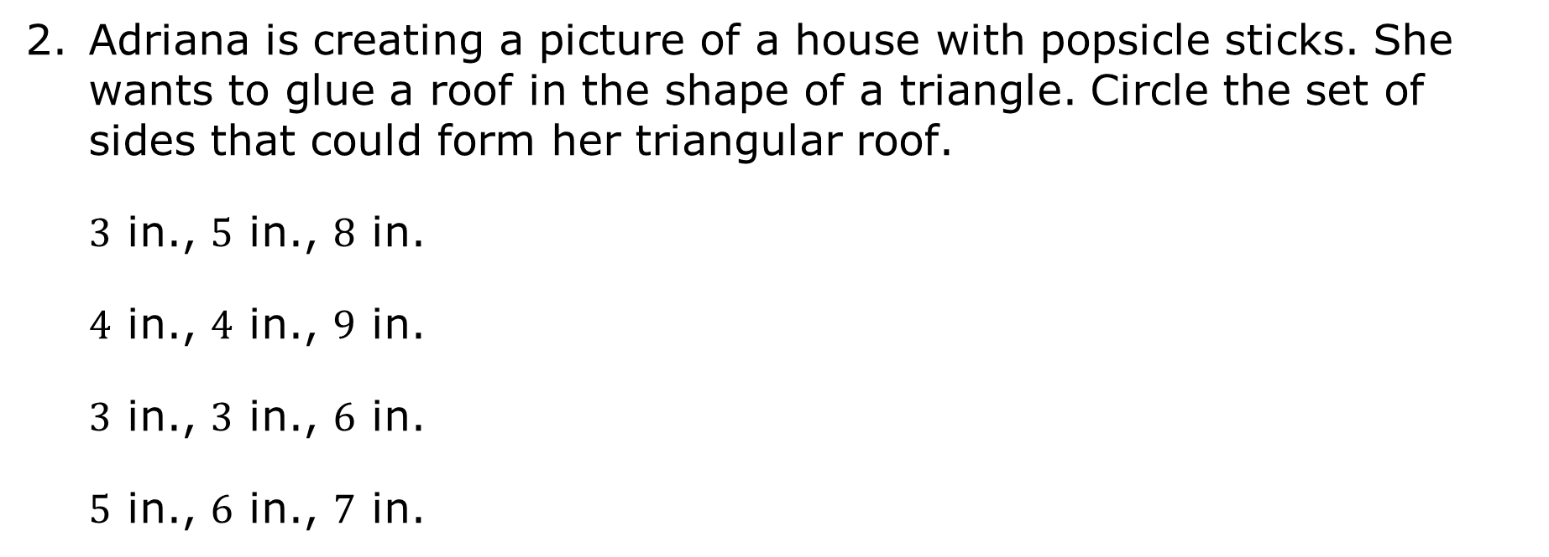
Adriana is creating a picture of a house with popsicle sticks. She wants to glue a roof in the shape of a triangle. Circle the set of sides that could form her triangular roof.
$3$ in., $5$ in., $8$ in.
$4$ in., $4$ in., $9$ in.
$3$ in., $3$ in., $6$ in.
$5$ in., $6$ in., $7$ in.
volume 1, pg. 199

Slide 19
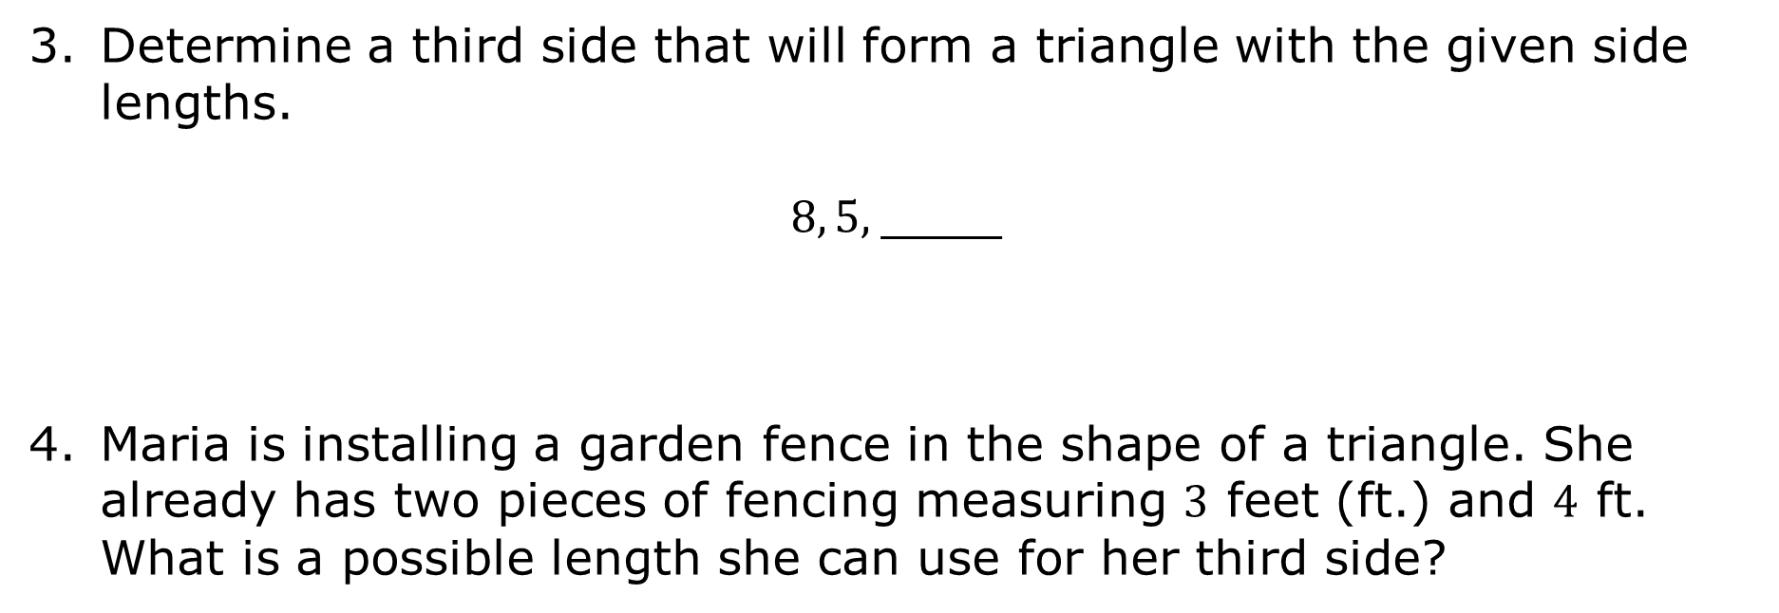
Determine a third side that will form a triangle with the given side lengths.
$8, 5,$____
Maria is installing a garden fence in the shape of a triangle. She already has two pieces of fencing measuring $3$ feet (ft.) and $4$ ft. What is a possible length she can use for her third side?
volume 1, pg. 200

Slide 20

Wrap-Up
volume 1, pg. 200

Slide 21
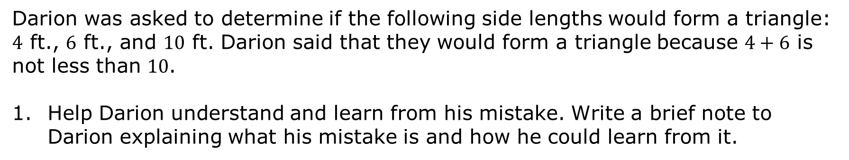
5.5.5 Wrap-Up: Error Analysis
Darion was asked to determine if the following side lengths would form a triangle: $4$ ft., $6$ ft., and $10$ ft. Darion said that they would form a triangle because $4+6$ is not less than $10$.
Help Darion understand and learn from his mistake. Write a brief note to Darion explaining what his mistake is and how he could learn from it.
volume 1, pg. 200

